Slide 1


Microprocessors and Assembly Language Spring 2020
Hamed Farbeh
farbeh@aut.ac.ir
Department of Computer Engineering
Amirkabir University of Technology
Lecture 17

Slide 2
Copyright Notice
Parts (text & figures) of this lecture are adopted from:
Arm Assembly Language Programming and Architecture, Volume 1, 1st edition, Muhammad Ali Mazidi, Sarmad Naimi, and Sepehr Naimi, MicroDigitalEd, 2013.
Microprocessors and Assembly Language, Spring 2020, AUT, Tehran, Iran

Slide 3
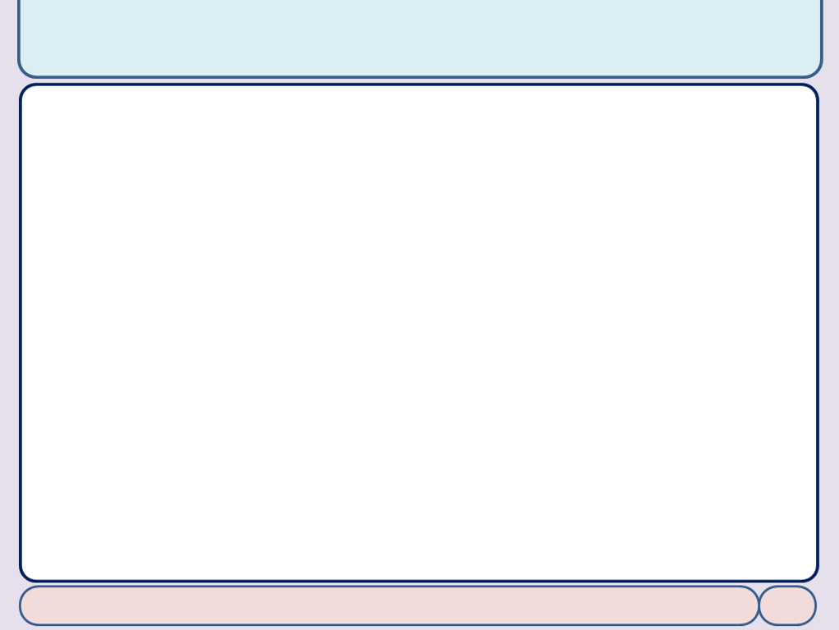
ARM Data Format, Pseudo-instructions and Directives ^{(cont.)}
Microprocessors and Assembly Language, Spring 2020, AUT, Tehran, Iran

Slide 4
Assembler Directives
Directives: EQU (equate)
To define a constant value or a fixed address by a name
To make the program easier to read
COUNT EQU 0x25
MOV R2, #COUNT ; R2 = 0x25
MOV R2, #0x25
Avoid searching the entire program trying to find and change every occurrence of a variable
Converted by Assembler to
Microprocessors and Assembly Language, Spring 2020, AUT, Tehran, Iran

Slide 5
Assembler Directives
Directives: EQU (equate)
Using EQU for fixed data assignment
DATA1 EQU 0x39 ; the way to define hex value
DATA2 EQU 2_00110101 ; the way to define binary value (35 in hex)
DATA3 EQU 39 ; decimal numbers (27 in hex)
DATA4 EQU '2' ; ASCII characters
Using EQU for special register address assignment
FIO2SET0 EQU 0x3FFFC058 ; PORT2 output set register 0 address
MOV R6, #0x01 ; R6 = 0x01
LDR R2, =FIO2SET0 ; R2 = 0x3FFFC058
STRB R6, [R2] ; Write 0x01 to FIO2SET0
Microprocessors and Assembly Language, Spring 2020, AUT, Tehran, Iran

Slide 6
Assembler Directives
Directives: EQU (equate)
Using EQU for RAM address assignment
SUM EQU 0x40000120 ; assign RAM location to SUM
MOV R2, #5 ; load R2 with 5
MOV R1, #2 ; load R1 with 2
ADD R2, R2, R1 ; R2 = R2 + R1
LDR R3, =SUM ; load R3 with 0x40000120
STRB R2, [R3] ; store the result SUM
Directives: RN (equate)
To give a CPU register a name
VAL1 RN R1 ; define VAL1 as a name for R1
VAL2 RN R2 ; define VAL2 as a name for R2
SUM RN R3 ; define SUM as a name for R3
Microprocessors and Assembly Language, Spring 2020, AUT, Tehran, Iran

Slide 7
Assembler Directives
Directives: INCLUDE
Tells the ARM assembler to read in the content of a file to the current program file
Microprocessors and Assembly Language, Spring 2020, AUT, Tehran, Iran

Slide 8
Assembler Data Allocation Directives
Directives to allocate memory and initialize its value
Directives: DCB
define constant byte
MYVALUE DCB 5 ; MYVALUE = 5
MYMSAGE DCB "HELLO WORLD" ; ASCII string
Each alphanumeric letter in a string is converted to its ASCII encoding value
Directives: DCW => define constant half-word
MYDATA DCW 0x20, 0xF230, 5000, 0x9CD7
Directives: DCD => define constant word
MYDATA DCD 0x200000, 0x30F5, 5000000, 0xFFFF9CD7
Microprocessors and Assembly Language, Spring 2020, AUT, Tehran, Iran

Slide 9
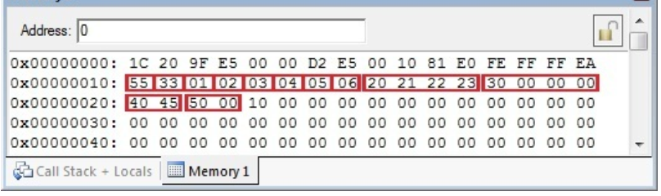
Assembler Data Allocation Directives
An sample program
AREA LOOKUP_EXAMPLE, READONLY, CODE
LDR R2, =OUR_FIXED_DATA ; point to OUR_FIXED_DATA
LDRB R0, [R2] ; load R0 with the contents of memory pointed to by R2
ADD R1, R1, R0 ; add R0 to R1
HERE B HERE ; stay here forever
OUR_FIXED_DATA
DCB 0x55, 0x33, 1, 2, 3, 4, 5, 6
DCD 0x23222120, 0x30
DCW 0x4540, 0x50
END
ADR R2, OUR_FIXED_DATA
Microprocessors and Assembly Language, Spring 2020, AUT, Tehran, Iran

Slide 10
Assembler Data Allocation Directives
Directives to allocate memory and initialize its value
Directives: SPACE
To allocate memory for variables without initial values
LONG_VAR SPACE 4 ; Allocate 4 bytes
OUR_ALFA SPACE 2 ; Allocate 2 bytes
Directives: ALIGN
To make sure data is aligned on the 32-bit word or 16-bit half word address boundary
ALIGN 4 ; the next instruction is word (4 bytes) aligned
...
ALIGN 2 ; the next instruction is half-word (2 bytes) aligned
...
Microprocessors and Assembly Language, Spring 2020, AUT, Tehran, Iran

Slide 11
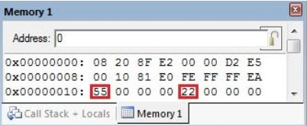
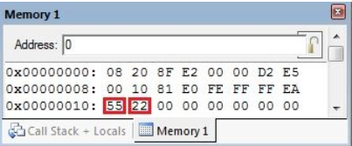
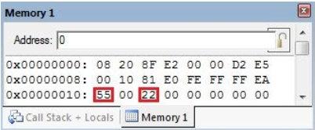
Assembler Data Allocation Directives
Directives: ALIGN
AREA E2_7A, READONLY, CODE ADR R2, DTA LDRB R0, [R2] ADD R1, R1, R0 H1 B H1 DTA DCB 0x55 DCB 0x22 END
DTA DCB 0x55 ALIGN 2 DCB 0x22 END
DTA DCB 0x55 ALIGN 4 DCB 0x22 END
Microprocessors and Assembly Language, Spring 2020, AUT, Tehran, Iran

Slide 12
Rules for Labels in Assembly Language
Each label name must be unique in the file
label names consist of
Alphabetic letters in both uppercase and lowercase
The digits 0 through 9, and
The special characters underscore ‘_’
The first character of the label must be
An alphabetical letter or underscore
Cannot be a numeral
Cannot be reserved words (ADD, MOV, …)
Microprocessors and Assembly Language, Spring 2020, AUT, Tehran, Iran

Slide 13
Creating an ARM Assembly Program
Microprocessors and Assembly Language, Spring 2020, AUT, Tehran, Iran

Slide 14
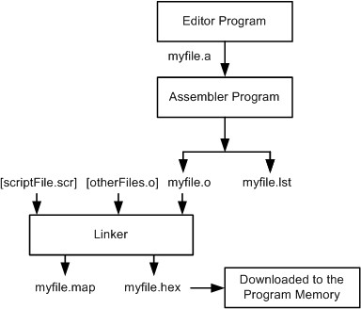
Creating an ARM Assembly Program
Steps to create a program
Microprocessors and Assembly Language, Spring 2020, AUT, Tehran, Iran

Slide 15
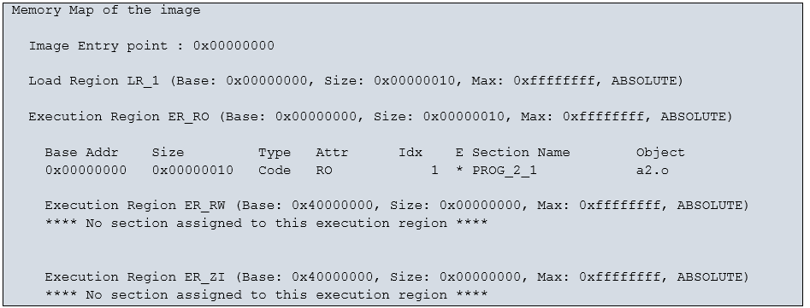
Creating an ARM Assembly Program
Sample of a Map File
Microprocessors and Assembly Language, Spring 2020, AUT, Tehran, Iran

Slide 16
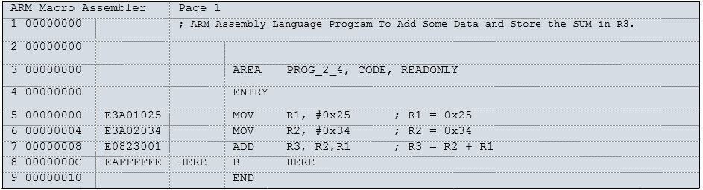
Creating an ARM Assembly Program
Sample of a List File
Microprocessors and Assembly Language, Spring 2020, AUT, Tehran, Iran

Slide 17
Power up Location for ARM
Q: At what address does the CPU wake up to when power is applied or when the CPU is reset?
ARM7 microcontrollers: 0x00000000
The first instruction is expected to be stored here
BUT, ARM Cortex-M is different
Reads from 0x00000004-0x00000007 and
Put them into the program counter, then
CPU fetches the first instruction using the content of PC
The programmer (working with the software tools) shall put the starting address of the program at memory location 0x00000004
Microprocessors and Assembly Language, Spring 2020, AUT, Tehran, Iran

